Slide 1


Types of Networking
Media

Slide 2


Types
Of Networking Media
TWISTED PAIR CABLE
1
COAXIAL CABLE
2
FIBER-OPTIC CABLE
3
WIRELESS MEDIA
4
SATELLITE COMMUNICATION
5

Slide 3




Networking Media
Network media, also known as network communication media, refers to the physical channels or pathways used for transmitting data between two or more devices in a computer network.
There are several types of network media, including wired and wireless technologies. Wired network media uses physical cables, such as twisted pair, coaxial, or fiber-optic cables, to transmit data. On the other hand, wireless network media uses radio waves or infrared signals to transmit data through the air without the need for physical cables.

Slide 4
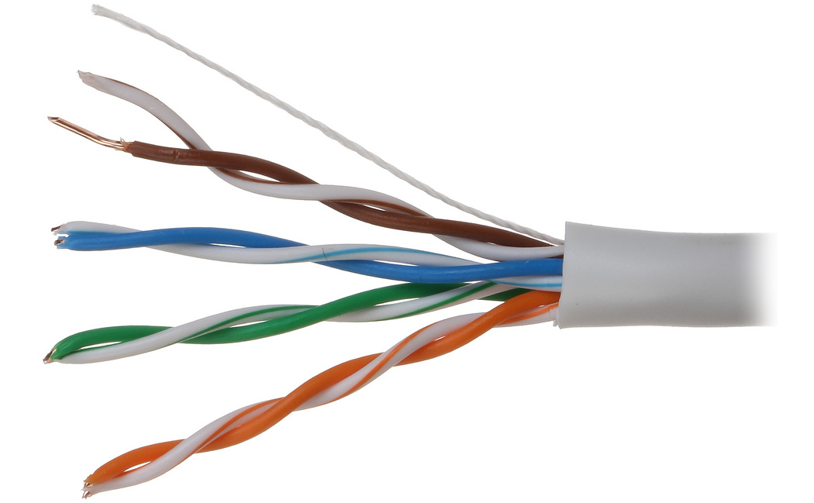
TWISTED PAIR CABLE
It consists of pairs of wires twisted together and is commonly used for Ethernet networks. Twisted pair cables can be shielded or unshielded, and they are suitable for shorter distances.

Slide 5
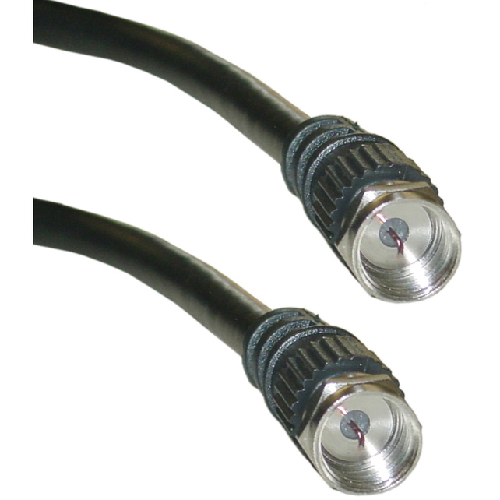
COAXIAL CABLE
It consists of a central conductor surrounded by an insulating layer, a shield, and an outer jacket. Coaxial cable is used in cable TV and can support higher bandwidths than twisted pair cables.
Read More >>

Slide 6
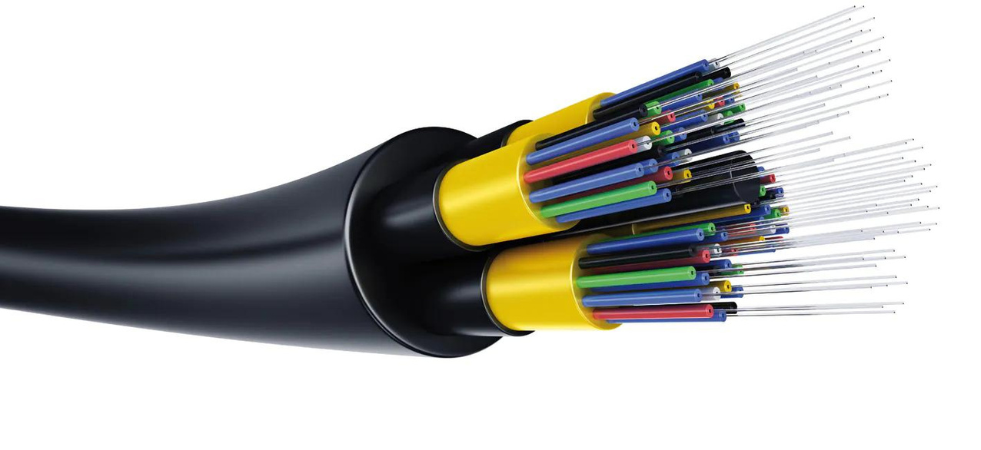
FIBER-OPTIC CABLE
It uses light signals to transmit data through a glass or plastic fiber. Fiber-optic cables can support very high bandwidths and are immune to electromagnetic interference, making them suitable for long-distance networks.
Read More >>

Slide 7

WIRELESS MEDIA
It includes radio waves and microwaves for transmitting data through the air. Wireless networks are convenient and flexible, but they can be susceptible to interference and have limited bandwidths.
Read More >>

Slide 8

SATELLITE COMMUNICATION
It involves the use of orbiting satellites to transmit data over long distances. Satellite communication is often used for remote locations where other forms of communication are not available or practical.
Read More >>

Slide 9

Thank You

